Slide 1
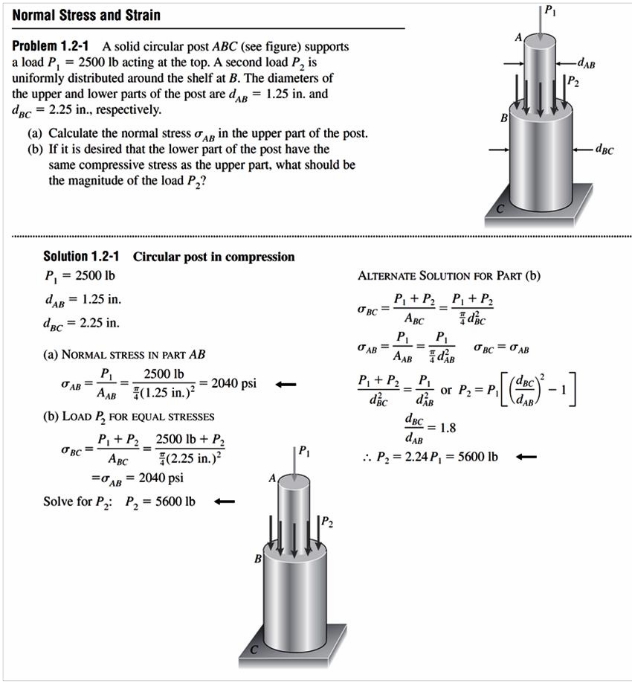
1.1.2 Compressive Stress and Strain
It is a stress produced in members because of push-type of load. It is denoted by (
σ_{c} )
𝐹
𝜎_{𝑐} = _{𝐴} , 𝜀_{𝑐} =
∆𝐿
𝐿
F A F
Where F is the force
A is the crossing area
L

Slide 2
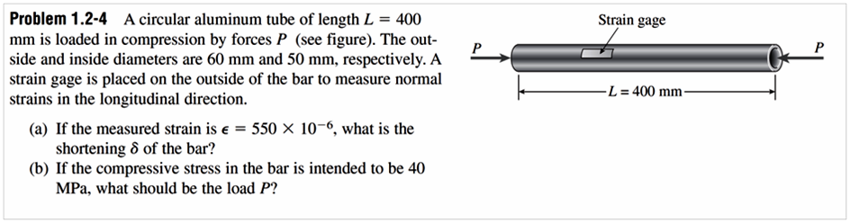
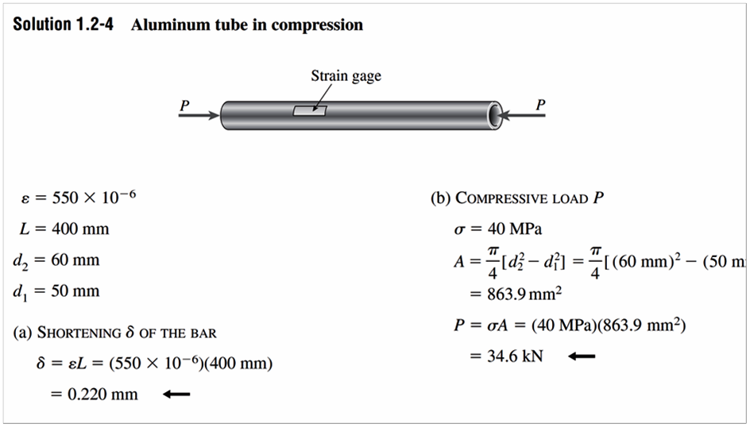
H.W

Slide 3
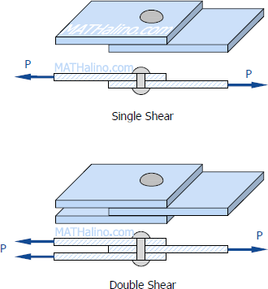
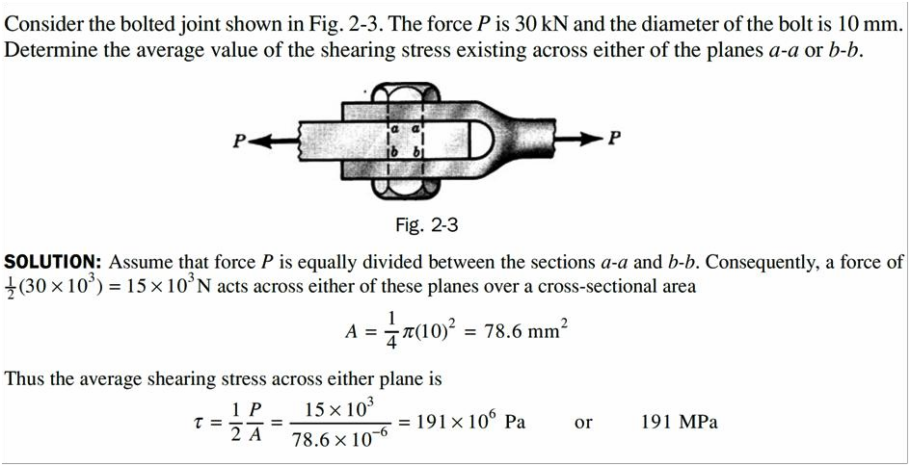
.1.3 Shear Stress and Strain
Shear stress: It is a stress produced in members when the load is tangential to the cross – section area. It is denoted by 𝜏
𝐹 𝑃
𝜏 = 𝑜𝑟
𝐴 𝐴
F = the force applied;
A = the cross-sectional area of material with area parallel to the applied force vector.
In double shear case the shear stress is
1 𝐹 1 𝑃
𝜏 = 𝑜𝑟
2 𝐴 2 𝐴
Example
Shear Strain
The change of angle at the corner of an originally rectangular element is defined as the
shear strain. It must be expressed in radians and is denoted by (𝛾).
Shear Modulus
The ratio of the shear stress 𝜏 to the shear strain 𝛾 is called the shear modulus and is denoted by G. Thus
G = τγ

Slide 4
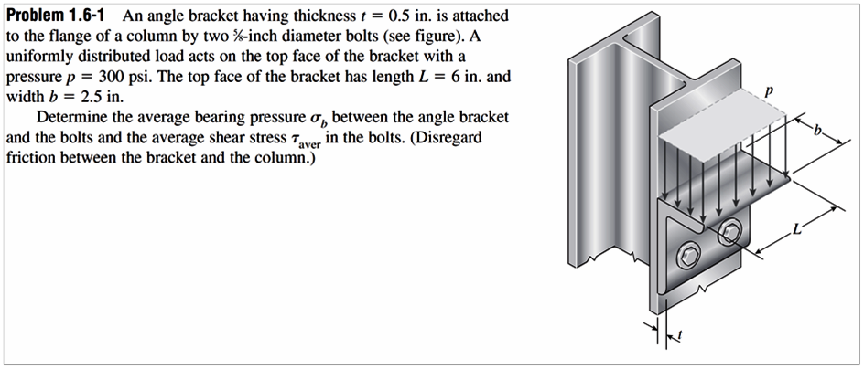
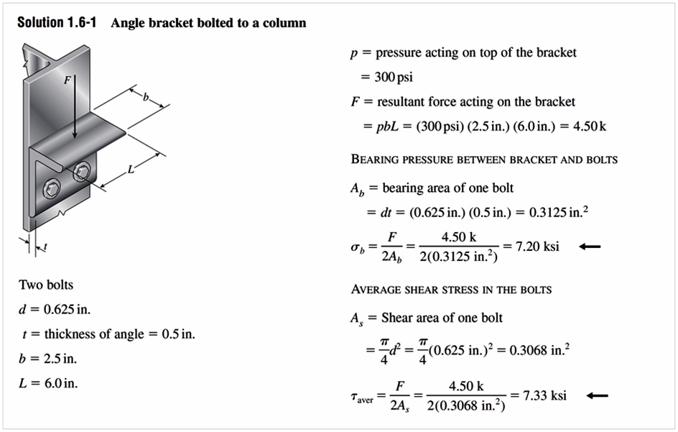
G is also known as the modulus of rigidity.
The units of G are the same as those of the shear stress, i.e., N/m², since the shear strain is dimensionless.
Example
Low-carbon structural steel has a shearing ultimate strength of approximately 300 MPa. Determine the force P necessary to punch a 2.5-cm-diameter hole through a plate of this steel 1 cm thick. If the modulus of elasticity in shear for this material is 82 GPa, find the shear strain at the edge of this hole when the shear stress is 143 MPa.
SOLUTION: Let us assume uniform shearing on a cylindrical surface is 2.5 cm in
diameter and 1 cm thick, as shown in Fig. For equilibrium the force P is
P
P = τ A = 0 025π × 0 01 × 300 × 10⁶ = 236 000N or 236 kN
To determine the shear strain g when the shear stress t is 143 MPa, we employ the definition G = τ γ / to obtain
1cm
𝜏 143 × 10⁶
𝛾 = =
𝐺 82 × 10⁹
2.5
= 0.00174 𝑟𝑎𝑑𝑖𝑎𝑛𝑠
H.W

Slide 5
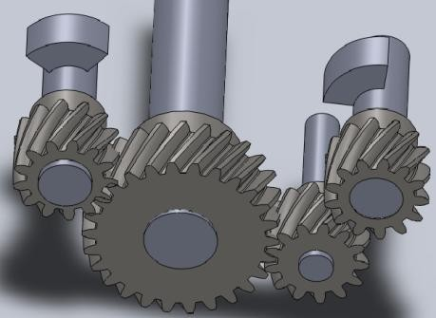
1.1.4 Torsional shear stress an Strain
It is a stress which exists in rotating members like shafts. It is denoted by (τ_{T})
𝜏_{𝑇} =
𝑇 × 𝜌 𝐴𝐵
𝑟𝜃
𝑇𝐿
𝜃 =
𝐺𝐽
𝐽
, 𝛼 = = ,
𝐿
𝐿
A
θ
θ ω
Where
T is the torque
ρ is the density of shaft
J is the moment of Inertia
r is the radius of section area
α
T
B
T
L
T
G is the ratio between shear stress to shear strain
A mathematical property of the geometry of the cross section which occurs in the study of the stresses set up in a circular shaft subject to torsion is the polar moment of inertia J, defined in a statics course. It is included for quick reference in Table (1)
Table (1)properties of selective area

Slide 6
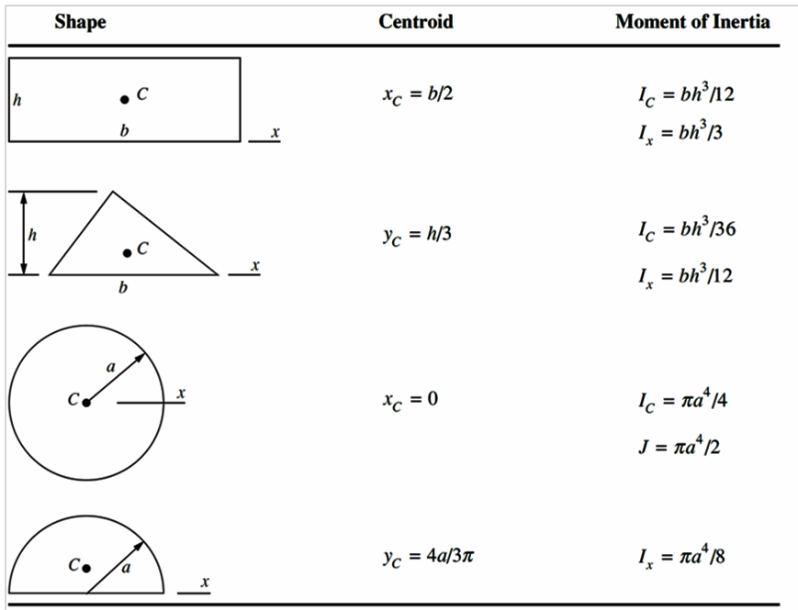
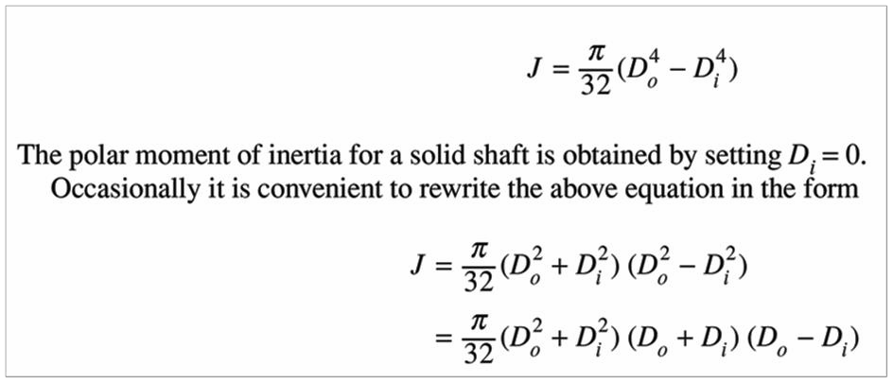
For a hollow circular shaft of outer diameter D_{o} with a concentric circular hole of diameter D_{i} the polar moment of inertia of the cross-sectional area is given by

Slide 7
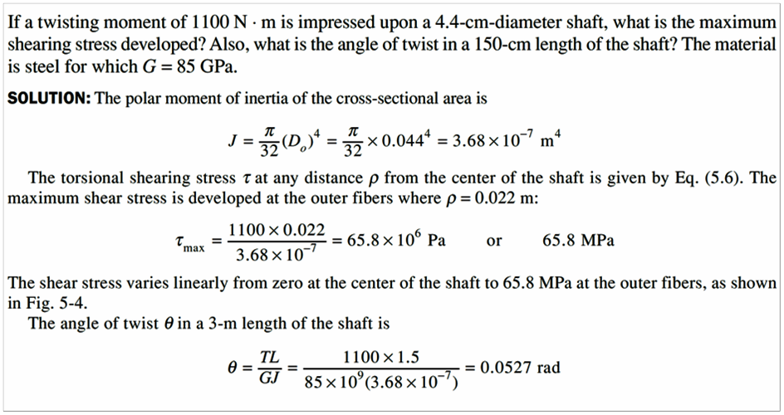
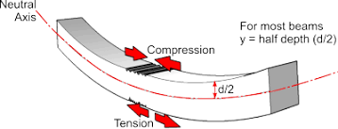
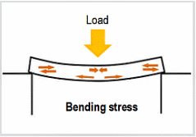
Example
1.1.5 Bending Stress
It is a stress which cause elongation of a members. It is dented by ( σ_{b} ).

Slide 8
𝜎_{𝑏} =
𝑀𝑐
𝐼
Where
M is the moment
𝑑
C is the distance between the top to the center (𝑐 = )
2
The resultant of the moments of all such elemental forces summed over the entire cross
section must be equal to the bending moment M acting at that section and thus we may write
𝑀 =
𝐸𝐼
𝜌
Where
E is the modulus of elasticity of the beam

Slide 9
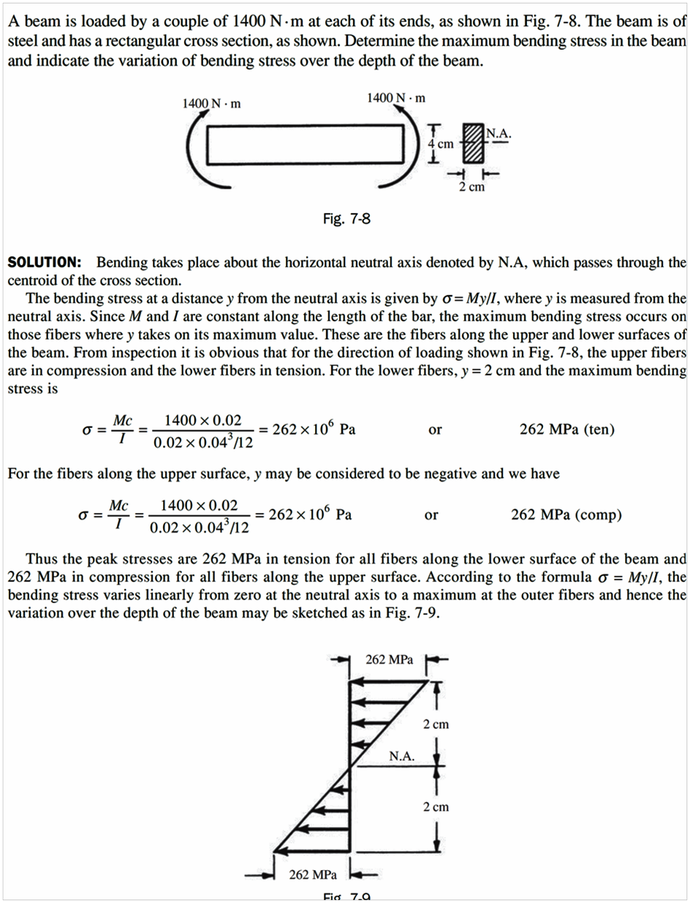
Example

Slide 10

1.2 Stress and Equiliberum
FREE-BODY DIAGRAM EXERCISES
In each of the five following examples, the body to be isolated is shown in the left-hand diagram, and an incomplete free-body diagram (FBD) of the isolated body is shown on the right. Add whatever forces are

Slide 11
